Slide 1
OPERATING SYSTEMS
LINUX BOOT PROCESS

Slide 3
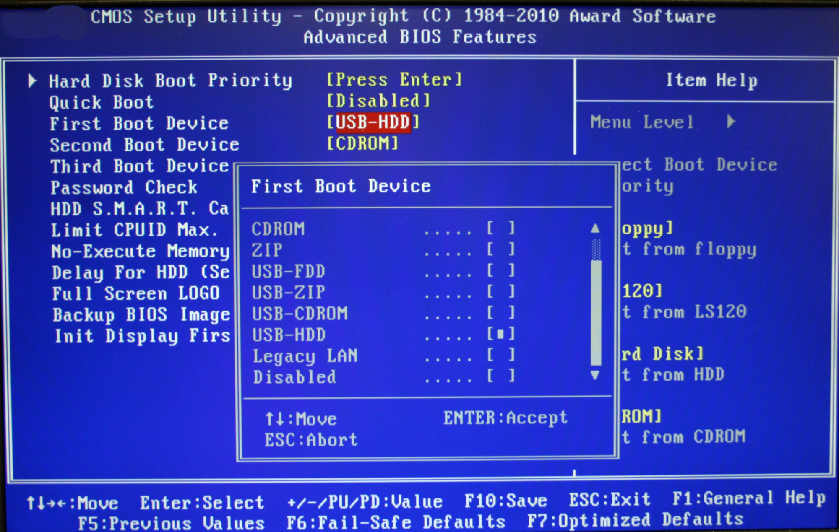

Slide 4
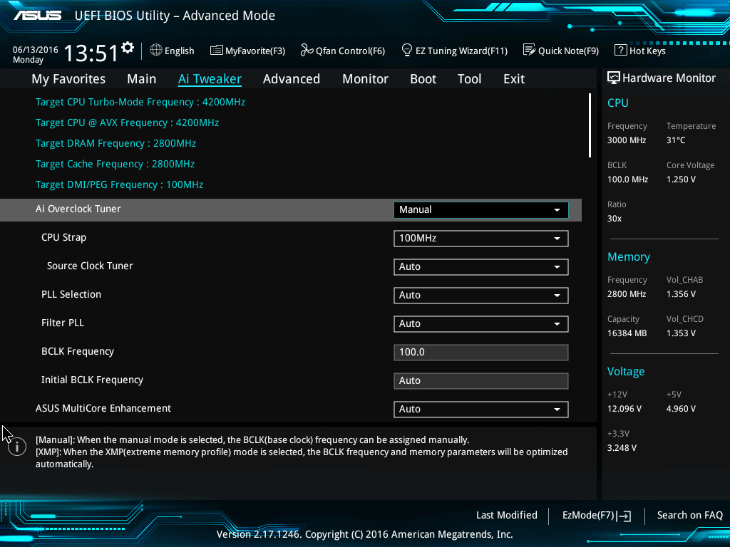
Unified Extensible Firmware Interface

